Slide 1
“COVID” Forecasting Cases & Deaths
Guided BY: | Team Member:
Jongwook Woo | Jay Joshi Shradha Shinde Sowmya Mareedu

Slide 2
Introduction
Corona is a deadly disease that started spreading throughout the world starting in December 2019. It was first diagnosed in Wuhan, China.
Since then, it has spread worldwide and has effected 2,475,440 people and 170,069 people have died due to this infection.
Scientists have since then dedicated their time in the research of this disease and here we attempt to take a deeper look into this problem.

Slide 3
Dataset
As this is Dataset URL :- https://github.com/datasets/covid-19
File Size : 81.7 Megabytes
Number of rows : 540
Number of Columns : 13
Number of File : 8
File Format : csv (Comma-separated Values)

Slide 4


Technical Specifications
Free Workspace
10 GB storage
Single node
R
Data Bricks Subscription
Cluster 5.2 (includes Apache Spark 2.4.0, Scala 2.11)
6 GB Memory, 0.88 Cores, 1 DBU
Python Version 3.2

Slide 5
In Azure ML, we have implemented ARIMA (Auto Regressive Integrated Moving Average) Seasonal & Non seasonal, ETS using R Extraction service ETS
For prediction of cases and deaths by weather factor we have implemented Linear Regression and Depth Forest Regression is implemented using pyspark in Databricks
For prediction of cases and deaths by time series prediction using Python Facebook Prophet in Databricks for prediction in Los Angeles and New York city.
We have used Oracle CLI for deaths and cases by weather factor for four cities
New York
Los Angeles
Washington
Philadelphia

Slide 6
Flowchart
Gathering Data
Data Preprocessing
Data Transformation
Data Split
Train and Test
Evaluate

Slide 7


Slide 8
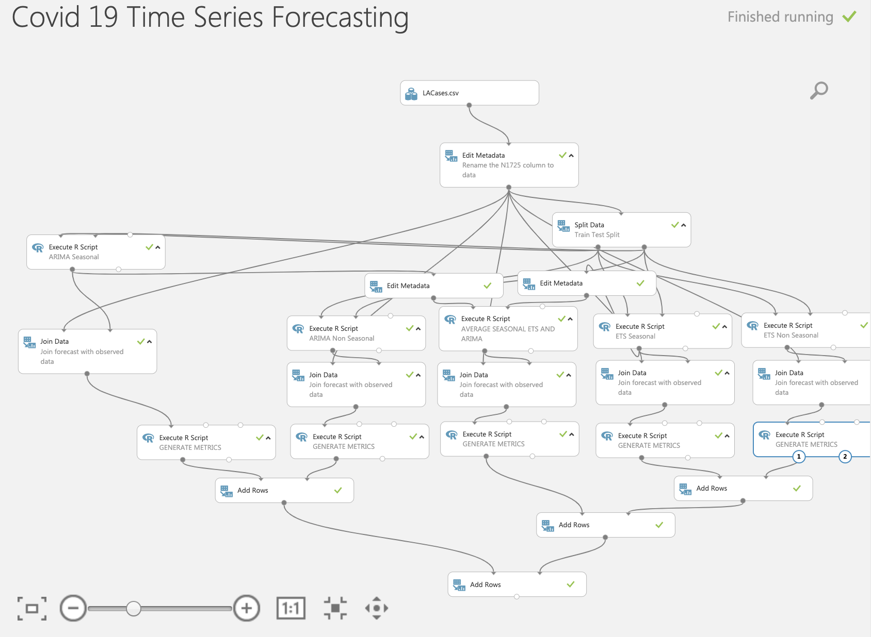

Slide 9
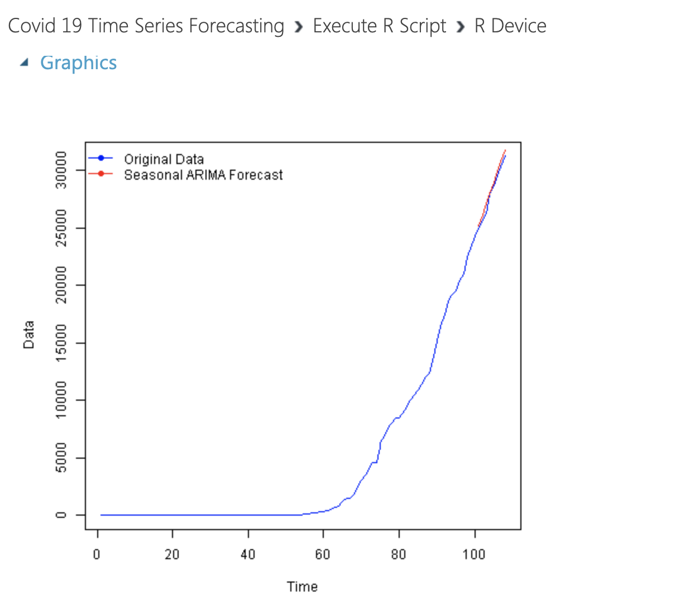
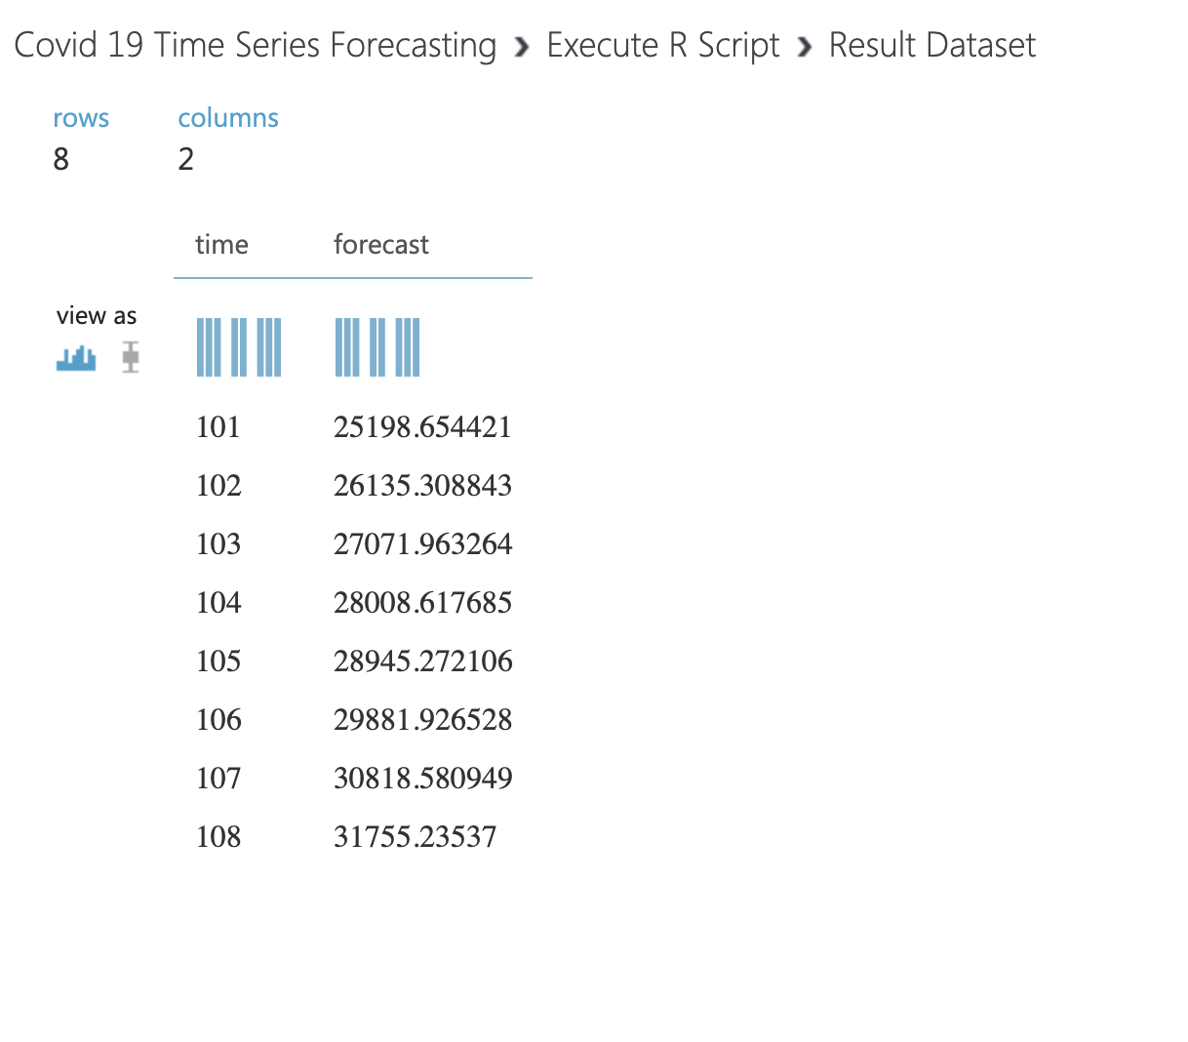
Results- Forecasting Graphs

Slide 10
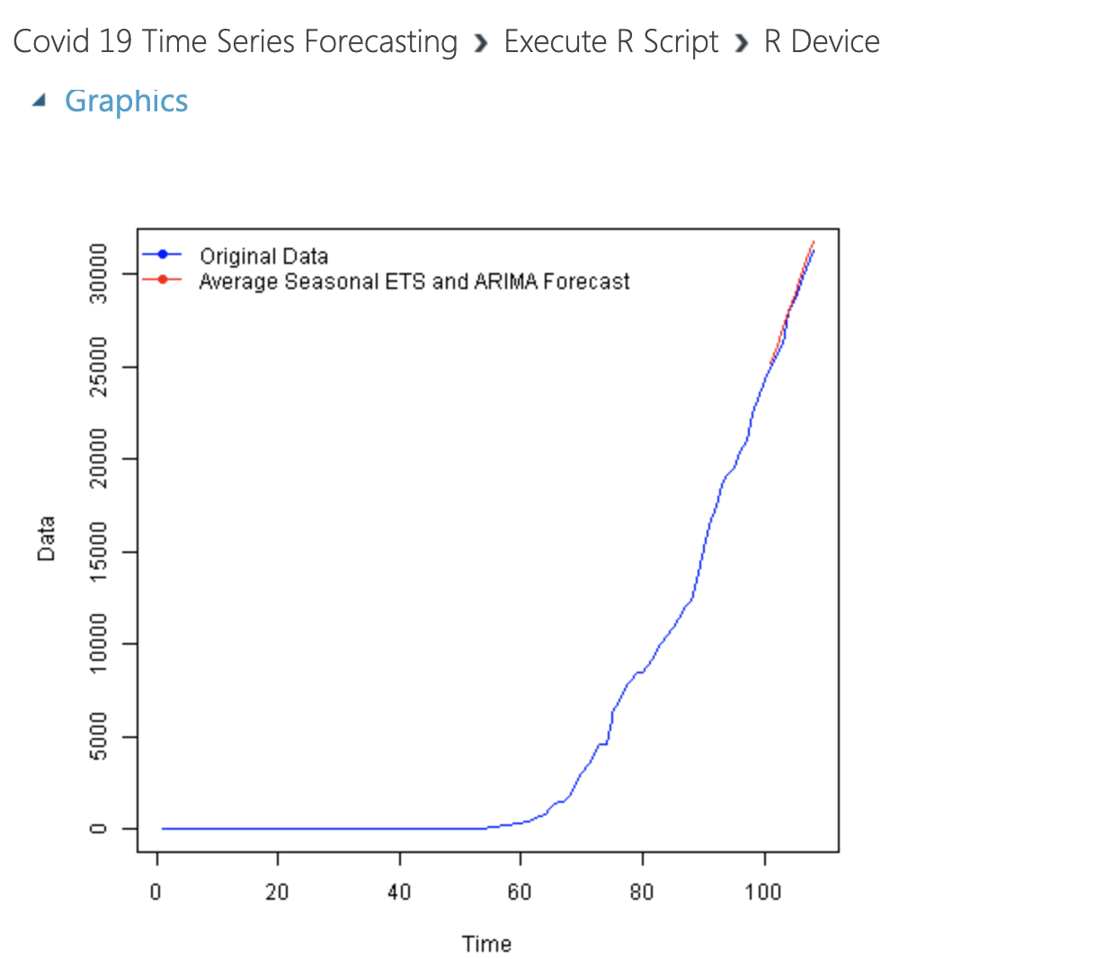
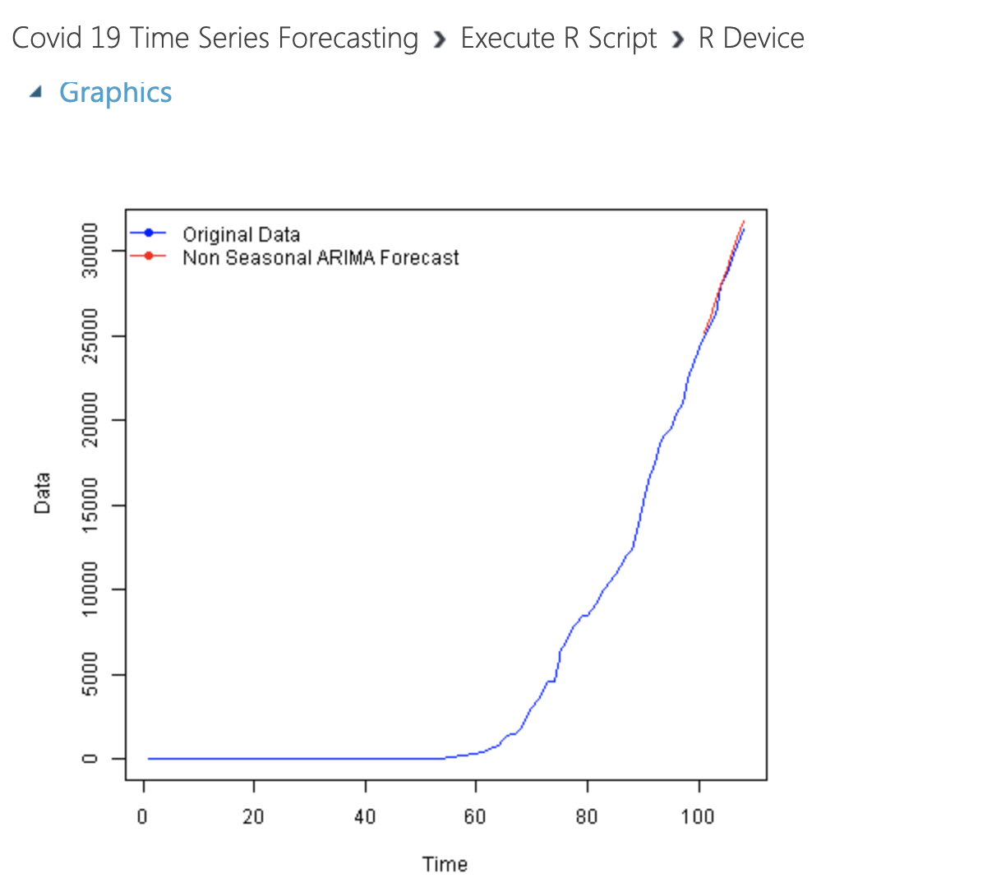
Results- Forecasting Graphs

Slide 11
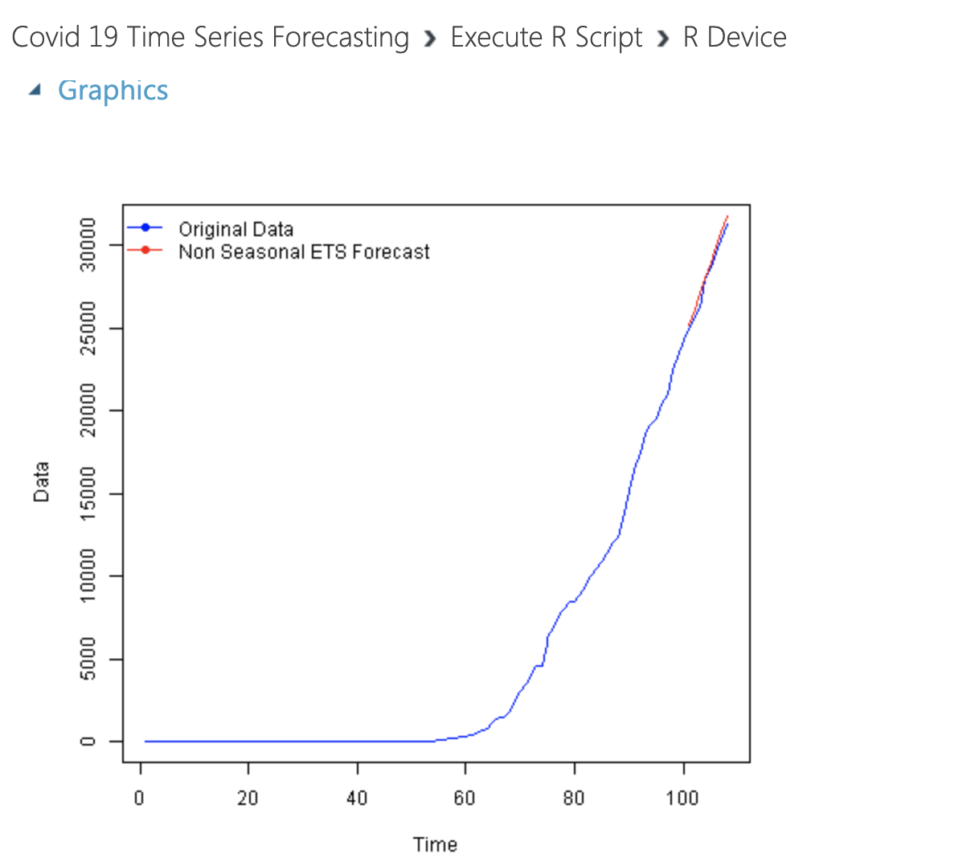
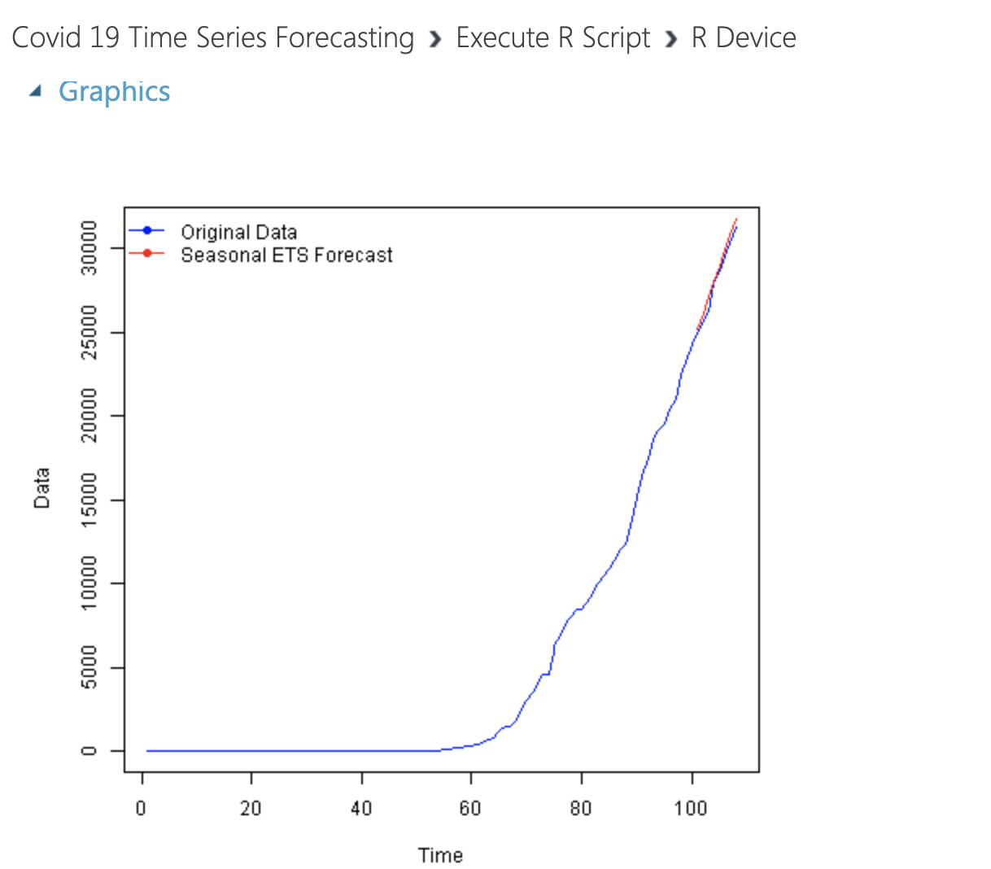
Results- Forecasting Graphs

Slide 12
Results- Forecasting Graphs

Slide 13
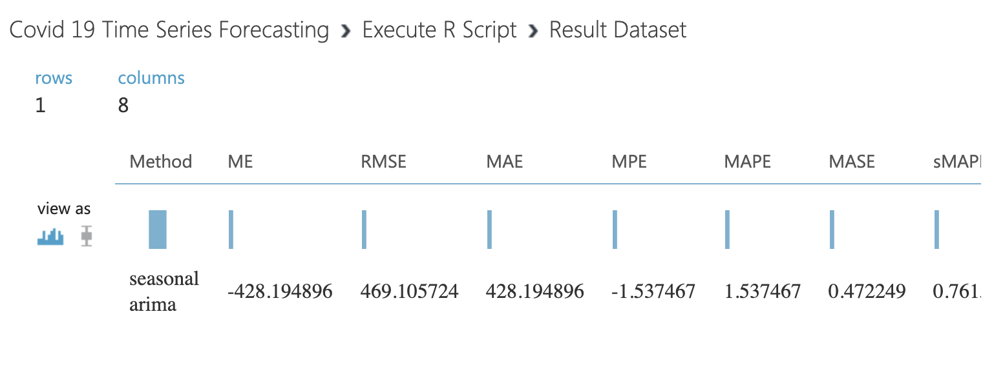
Results - RMSE
Method: Season ARIMA

Slide 14
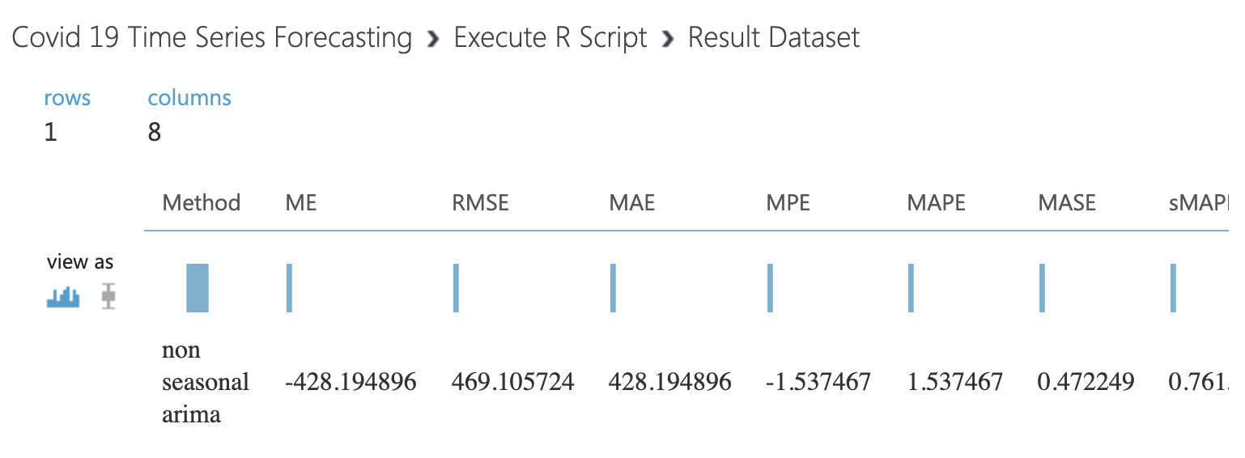
Results - RMSE
Method: Non- Seasonal ARIMA

Slide 15
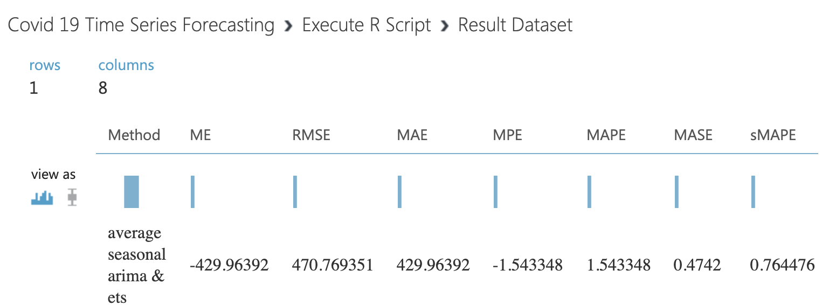
Results - RMSE
Method: Average Seasonal ARIMA & ETS

Slide 16
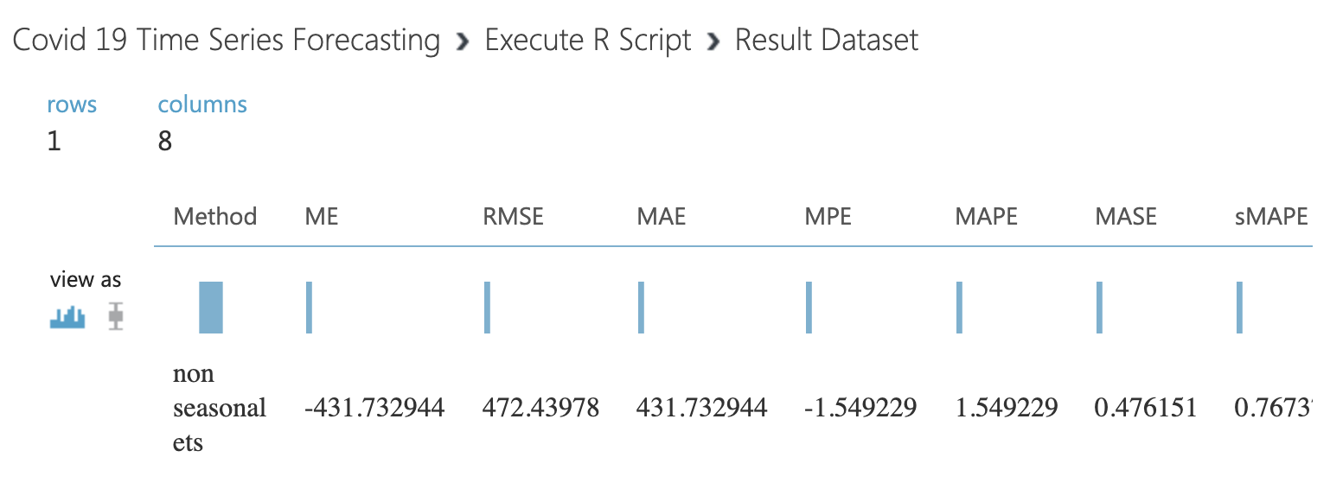
Results - RMSE
Method: Non- Season ETS

Slide 17
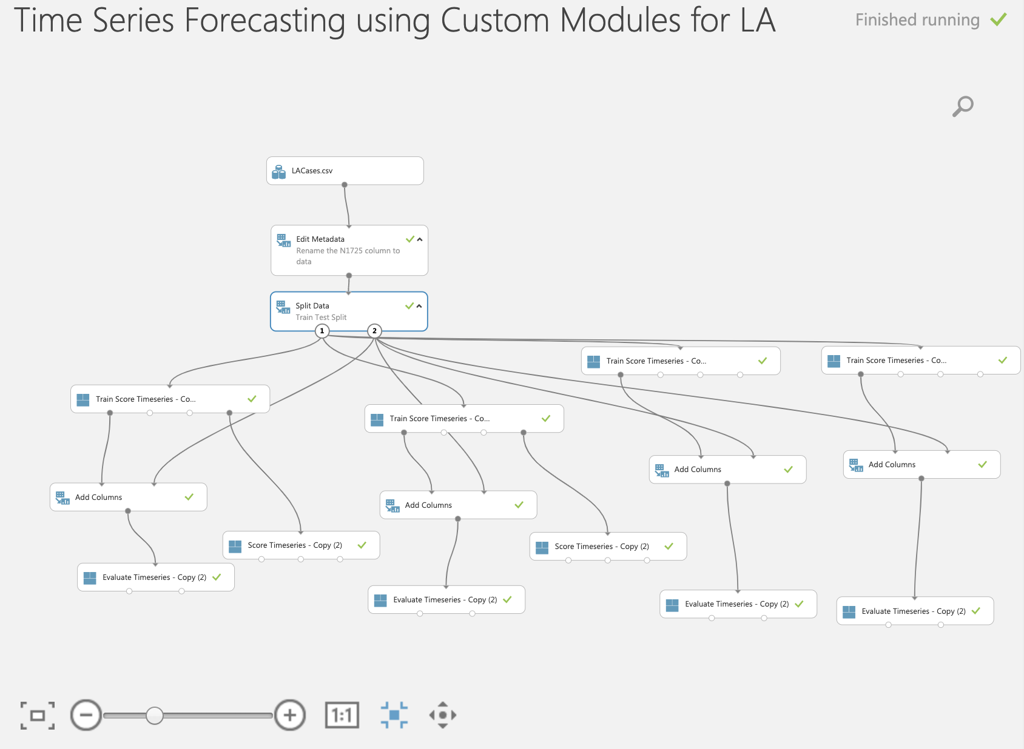
Time Series Forecasting

Slide 18
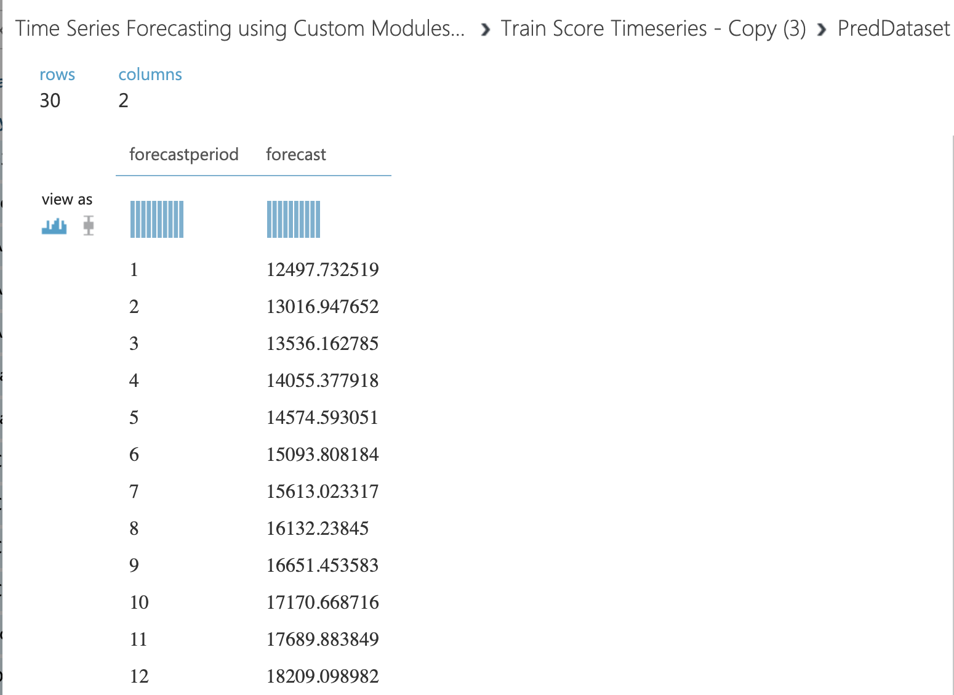

Results – Custom Module

Slide 19
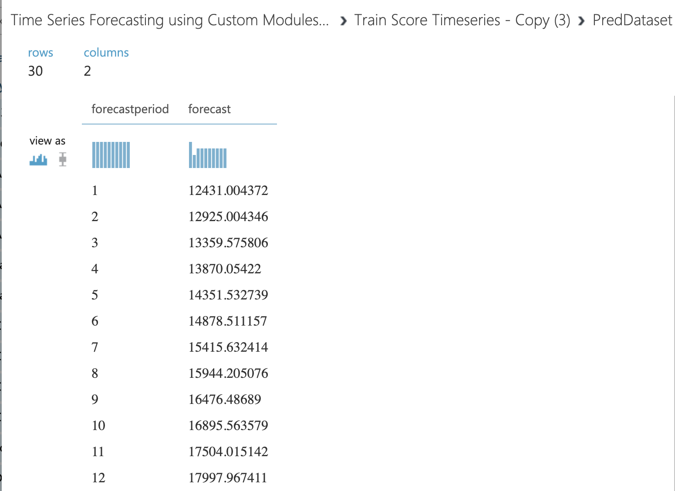
Results – Custom Module

Slide 20


Slide 21
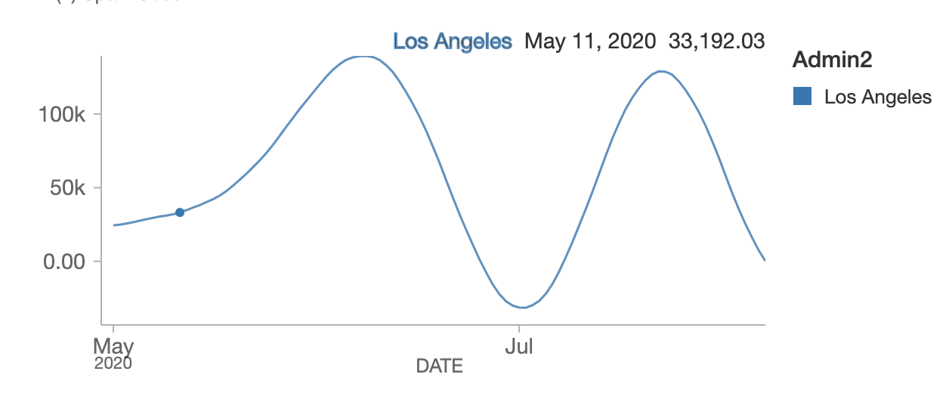
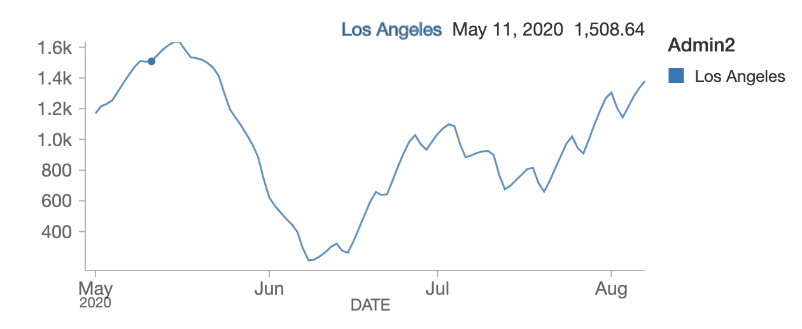
Time Series Prediction- Los Angeles
Cases
Deaths

Slide 22
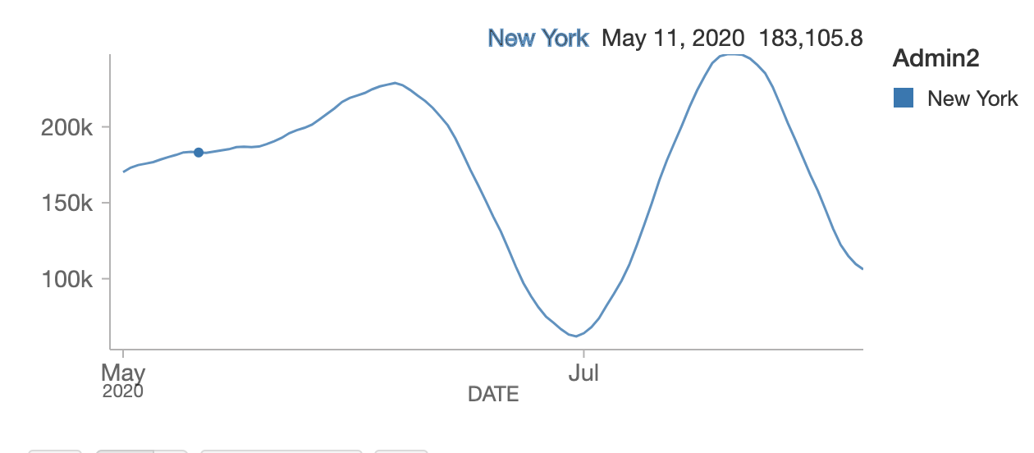
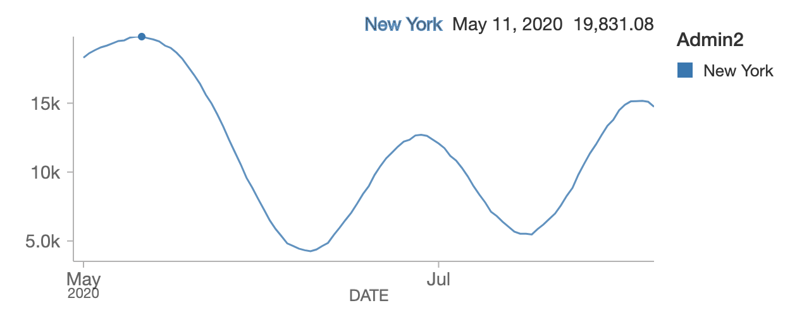
Time Series Prediction- New York
Cases
Deaths

Slide 23
Results- AUC (Los Angeles)- Weather Factor
Cases
Los Angeles using LR Algorithm: 0.3656716417910448
Los Angeles using DR Algorithm: 0.353982300884975
Deaths
Los Angeles using LR Algorithm: 0.536
Los Angeles using DR Algorithm: 0.315789473682105

Slide 24

Oracle CLI

Slide 25
Results- AUC (Los Angeles)
Cases
Los Angeles using LR Algorithm: 0.387596899224
Los Angeles using DR Algorithm: 0.3
Deaths
Los Angeles using LR Algorithm: 0.4672131147540984
Los Angeles using DR Algorithm: 0.41134751773

Slide 26
Results- AUC (New York)
Cases
New York using LR Algorithm: 0.32596899224
New York using DR Algorithm: 0.31
Deaths
New York using LR Algorithm: 0.419689927540984
New York using DR Algorithm: 0.40

Slide 27
Conclusion
Weather Factor is not prominent in prediction of deaths due to COVID.
In Azure ML, ARIMA seasonal and non seasonal forecast is better compared to other algorithms.
In comparison with WORLDOMETER, we have decent similar results for predicting number of cases and deaths.
Since we were able to get decent predictions using simple deaths over time, we would want to look at multiple regressions and see how that affects coronavirus death rates.

Slide 28

Thank you!
Taken from https://en.wikipedia.org/wiki/Mickey_Mouse

